Slide 1

Mastering Bicep Infrastructure as Code for Azure!
Freek Berson @fberson

Slide 2





Sponsors & organizers
Thanks to sponsors:
Thanks to organizers: Drago Petrovic and Stoyan Chalakov.

Slide 3











About Freek Berson
Focus
Certifications
End User Computing, Infrastructure as Code
From
Books
Picture
The Netherlands
- Getting started with Bicep
- RDS - The Complete Guide
My Blog
Contact
Themicrosoftplatform.net
@fberson
github.com/fberson

Slide 4
Agenda
Brief introduction into IaC, ARM, and Bicep
Demos, demos, demos ☺
Call to action

Slide 5
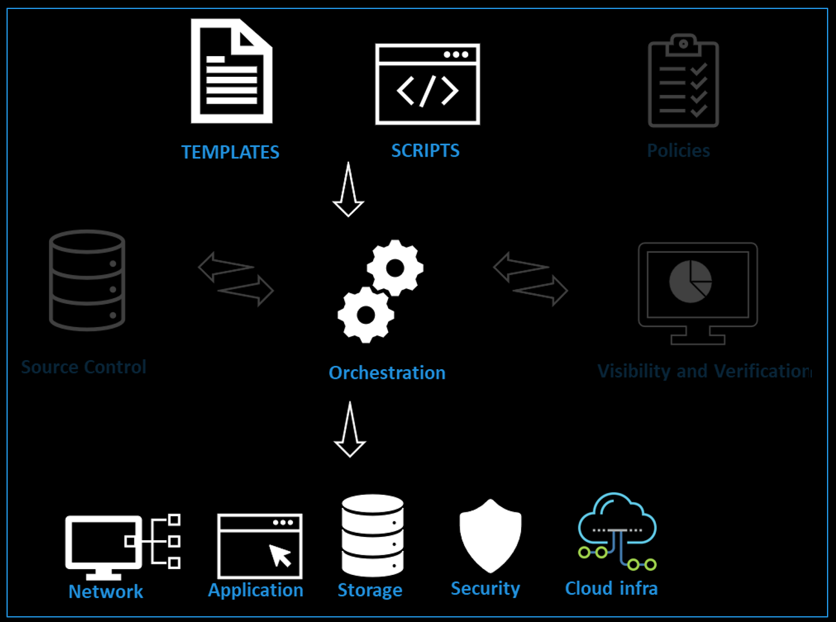
Infrastructure as Code (IaC)
"..the process of provisioning infrastructure resources similar to how software is deployed."

Slide 6
Imperative code vs Declarative code
Imperative code
You execute a sequence of commands, in a specific order, to reach an end configuration.
This process defines the what and how.
You specify only the end configuration. The code doesn't define how to accomplish the task.
Declarative code

Slide 7
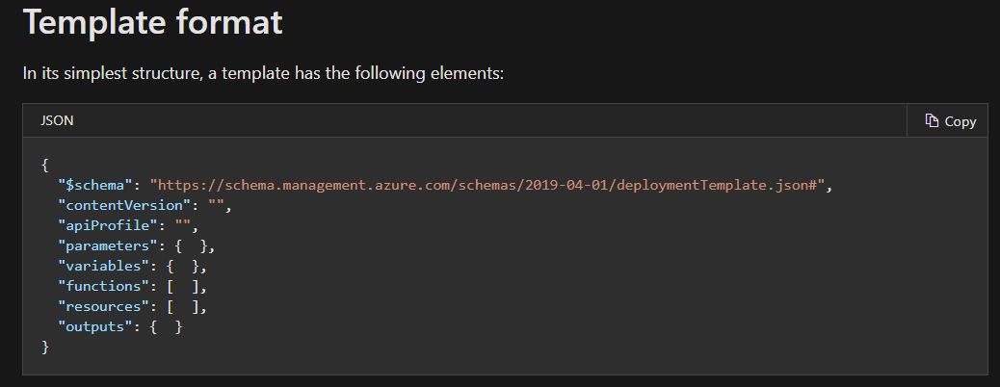
ARM Template

Slide 8


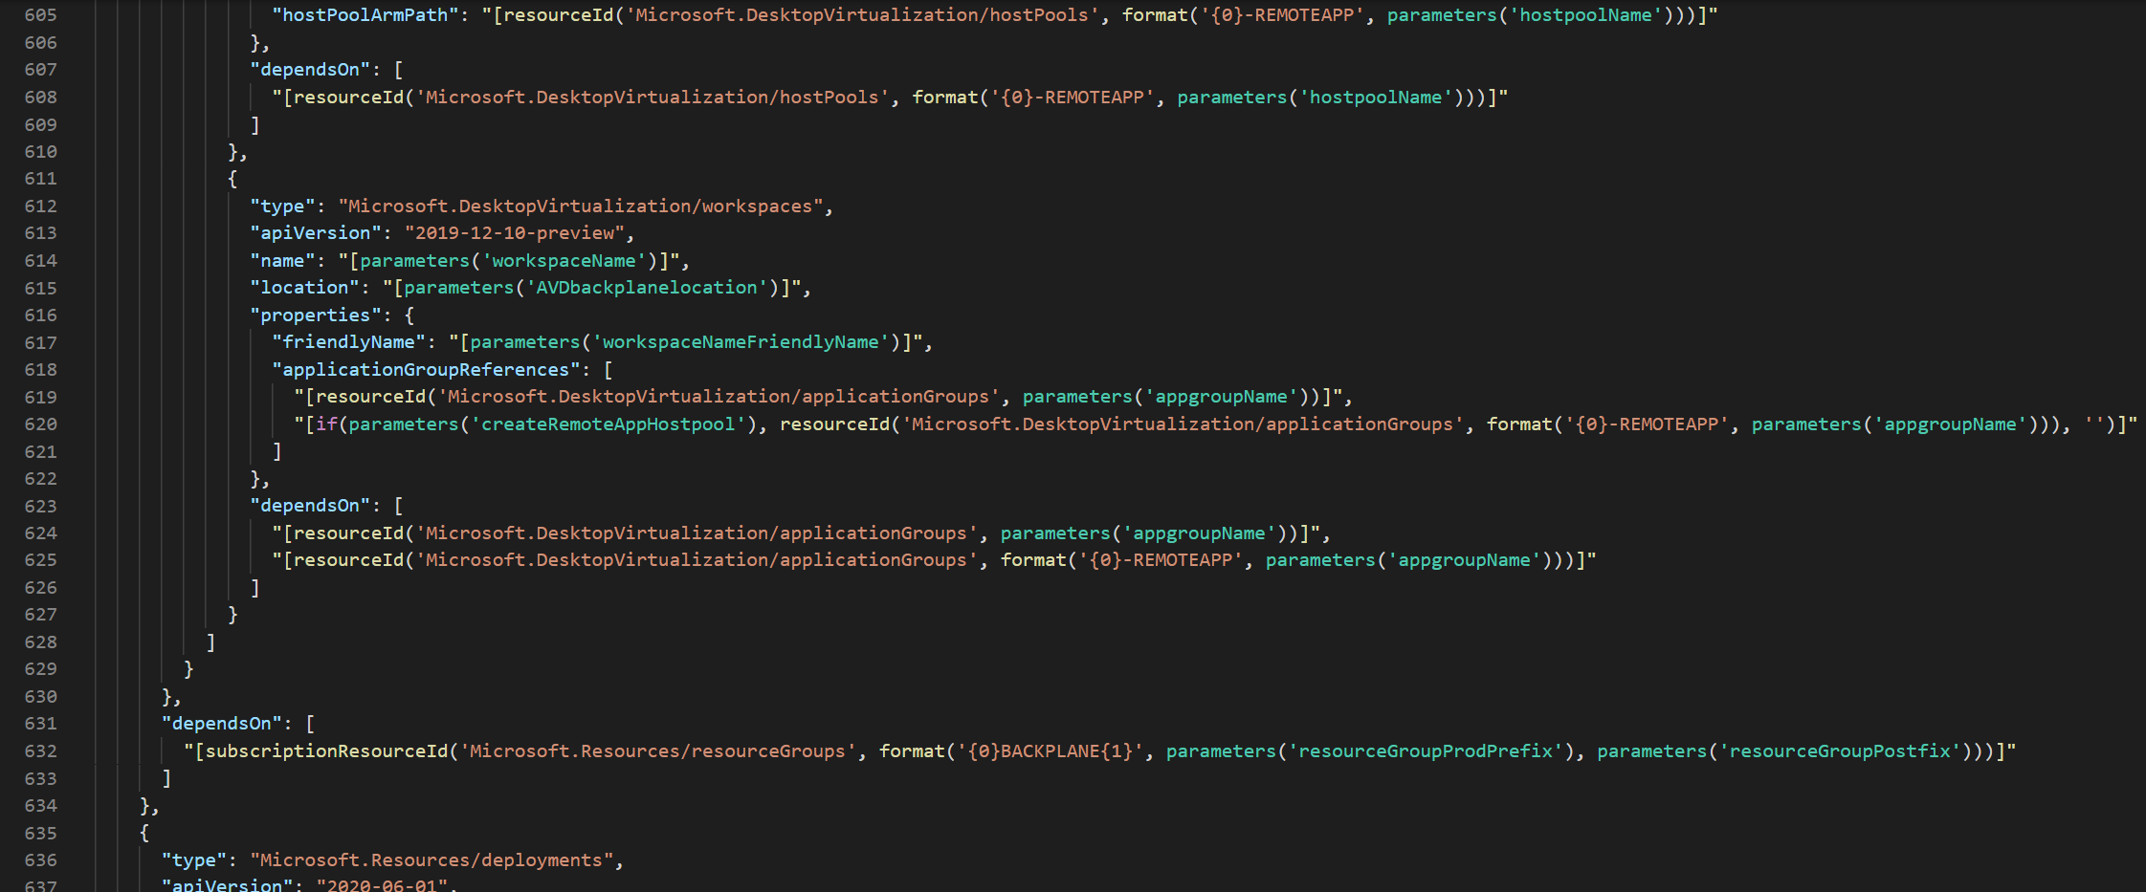
ARM Template complexity

Slide 9

What is Bicep?
".. Bicep is a Domain Specific Language (DSL) for deploying Azure resources declaratively. It aims to drastically simplify the authoring experience with a cleaner syntax and better support for modularity and code re-use. Bicep is a transparent abstraction over ARM and ARM templates."

Slide 10
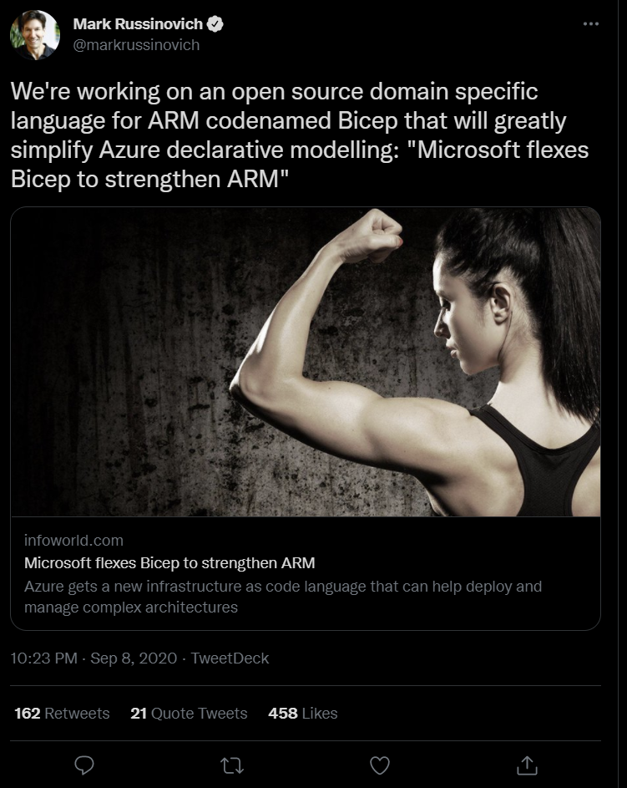
Project ‘Bicep’

Slide 11
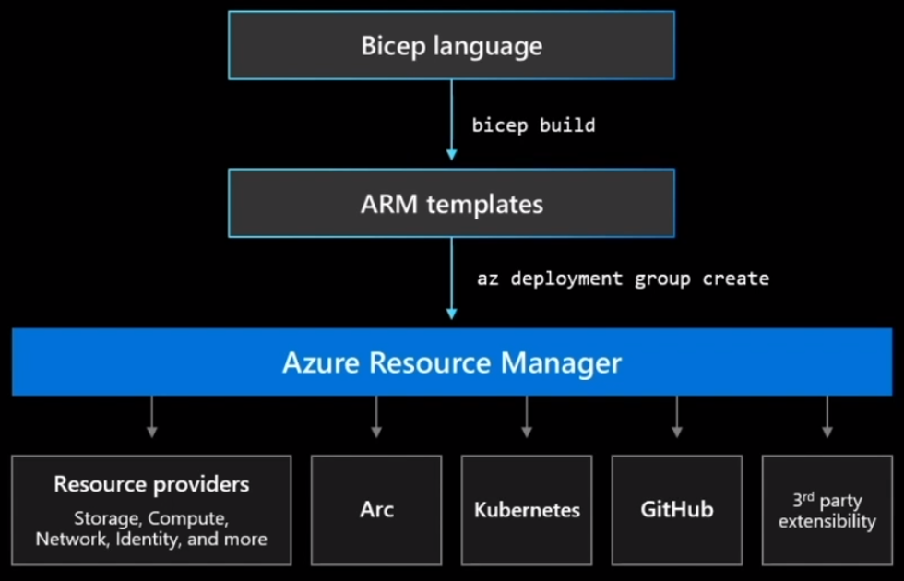
Where to position Bicep?
Intuitive
Easy to read and to author
Transpiles to ARM Templates Leverage ARM template knowledge and investments Modular
Abstract common blocks of code into reusable parts
Open Source
Transparency and community

Slide 12
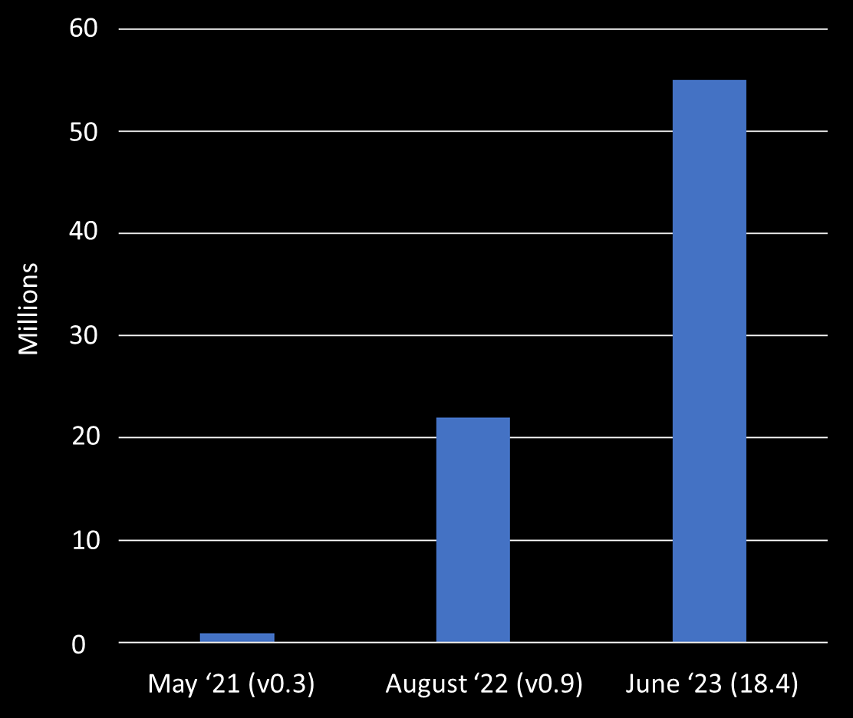
How well is Bicep adopted?
61
Number of resources deployed using Bicep in last 30 days
Sep ’23 (0.21)

Slide 13
Demos
1. Creating a Bicep template from scratch
2. Optimize authoring experience with VSCode
3. Modules
4. Large scale use case
5. Deployment stacks

Slide 14
Call to action!
Bicep MS Docs: Aka.ms/bicep
Bicep Monthly Community call surveymonkey.com/r/ARMnews
Bicep GitHub location github.com/Azure/bicep
Bicep Learning path docs.microsoft.com/en-us/azure/azure-resource-manager/bicep/learn-bicep

Slide 15
Mastering Bicep –
Infrastructure as Code for Azure!
Freek Berson @fberson

